Slide 1
Self-Scheduled Vaccinations via MyChart
Empowering Patients & Increasing Access
David Bar-Shain, MD
Population Health and Equity Research Institute (PHERI)
2024-02-23
9:00 – 10:00 am EST

Slide 2
Disclosures:
David Bar-Shain, MD has no relevant
financial disclosures to make for this talk.

Slide 3

Agenda
Introduction
What we built
Outcomes
Conclusions
Discussion
Icon created by Freepik
Flaticon.com

Slide 4
Agenda
Introduction
  Learning objectives
  Focus questions
  MetroHealth’s environment
  Project goals
What we built
Outcomes
Conclusions
Discussion
Icon created by Freepik
Flaticon.com

Slide 5

Learning Objectives:
Describe how MetroHealth implemented
self-scheduled vaccinations via MyChart.
Understand why we have seen a big jump in HPV administrations in patients 27 yrs through 45 yrs.
Discuss difficulties surrounding “Shared Decision-Making” recommendations in an EHR.
Generate research questions.
Icon created by Freepik
Flaticon.com

Slide 6
Agenda
Introduction
  Learning objectives
  Focus questions
  MetroHealth’s environment
  Project goals
What we built
Outcomes
Conclusions
Discussion
Icon created by Freepik
Flaticon.com

Slide 7

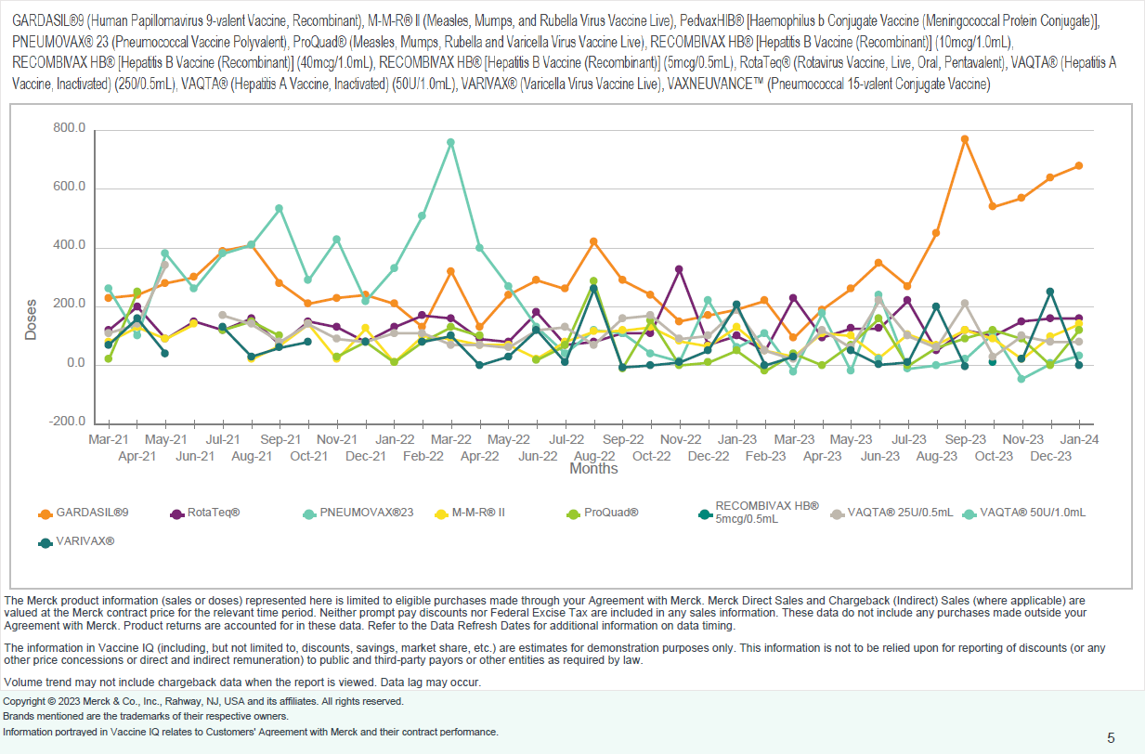
Focus Question #1:
How can we explain this increase in HPV purchases?
Doses of
HPV vaccine purchased from Merck
Icon created by Freepik
Flaticon.com
Product Volume Trend Chart
February 2021 to December 2023
Vaccine IQTM
The MetroHealth System
(Report Run: February 15, 2024)
Merck & Co. Inc.

Slide 8
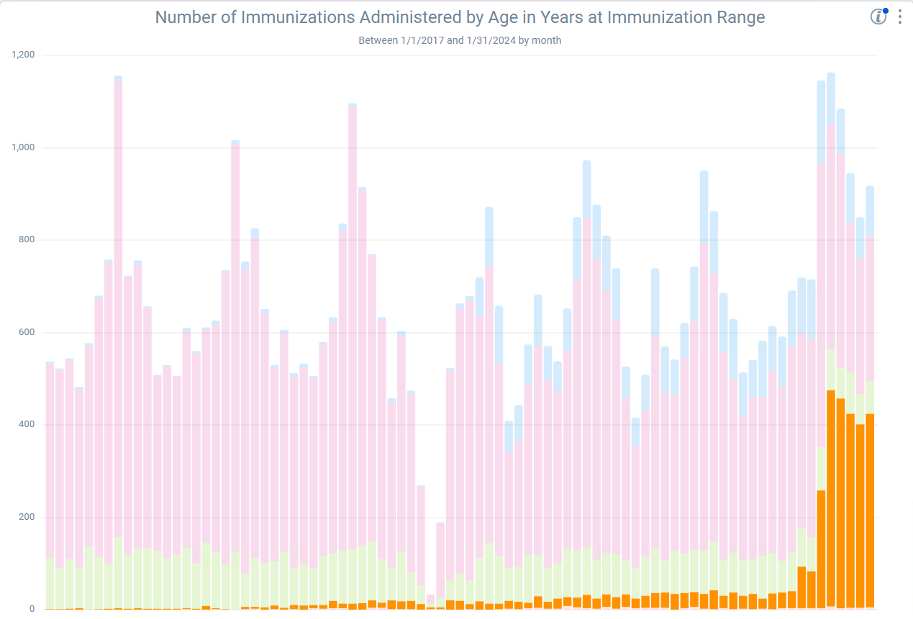
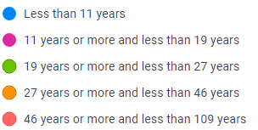
Focus Question #2:
How can we explain this increase in HPV administrations?
Number of HPV Doses Given Per Month by Age
(January 2017 through January 2024) Source: SlicerDicer
Icon created by Freepik
Flaticon.com
Number of Doses Given
August 2023
Doses of HPV vaccine given to patients 27 - 45 years of age started to increase dramatically in August/September 2023
Month

Slide 9
Focus Question #3:
Is it appropriate to forecast Shared Decision-Making for HPV vaccine for adults 27 years through 45 years via Epic’s Health Maintenance and show it to providers?
  CDC:
  “Adults age 27–45 years: Based on shared clinical decision-making, complete a 2-dose series (if initiated age 9-14 years) or 3-dose series (if initiated ≥15 years)”
  https://www.cdc.gov/vaccines/schedules/hcp/imz/adult-schedule-notes.html#note-hpv
Icon created by Freepik
Flaticon.com

Slide 10
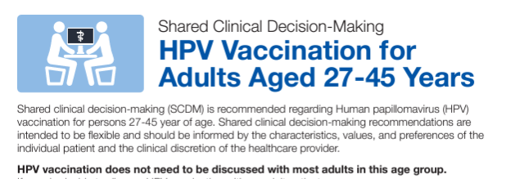
Focus Question #4:
Is it appropriate to share an HPV Shared Decision-Making forecast with patients?
  CDC:
Icon created by Freepik
Flaticon.com
https://www.cdc.gov/vaccines/hcp/admin/downloads/isd-job-aid-scdm-hpv-shared-clinical-decision-making-hpv.pdf

Slide 11
Focus Question #5:
Using your lenses of ...
Population Health & Health Disparities
... what research questions do you have about MetroHealth’s self-scheduled vaccinations via MyChart?
Icon created by Freepik
Flaticon.com

Slide 12
Agenda
Introduction
  Learning objectives
  Focus questions
  MetroHealth’s environment
  Project goals
What we built
Outcomes
Conclusions
Discussion
Icon created by Freepik
Flaticon.com

Slide 13

MetroHealth’s Environment
Epic Enterprise Customer
  EpicCare Ambulatory (EHR)
  Cadence (scheduling module)
  MyChart (patient portal)
  Clarity (reporting)
Vaccinations
  We provide patient-specific forecasts visible to provider & patient
Organizational Assets
  Collaborative culture across disciplines
  Subject matter experts empowered to make changes
  Long history of customization
Icon created by Freepik
Flaticon.com

Slide 14
Agenda
Introduction
  Learning objectives
  Focus questions
  MetroHealth’s environment
  Project goals
What we built
Outcomes
Conclusions
Discussion
Icon created by Freepik
Flaticon.com

Slide 15

PROBLEM #1:
Patients could see that a vaccine was due in MyChart...But they could NOT self-schedule a vaccination appointment.
Project Background:
Icon created by Freepik
Flaticon.com
GOAL #1:
Increase access by enabling
self-scheduled vaccination appointments via MyChart (but allow telephone option, too).

Slide 16

PROBLEM #2:
Patients may want to schedule vaccination appointments in advance of the due date.
Project Background:
Icon created by Freepik
Flaticon.com
GOAL #2:
Allow self-scheduling up to 1-month before the vaccine due date.

Slide 17

PROBLEM #3:
Patients may not want all the vaccines that are due.
Project Background:
Icon created by IconBaandar
Flaticon.com
GOAL #3:
Query the patient at the time of scheduling to identify the desired vaccine(s).

Slide 18

PROBLEM #4:
Vaccines may be due on different dates.
Project Background:
Icon created by Freepik
Flaticon.com
GOAL #4:
Only offer self-scheduled vaccination appointments ON or AFTER the date that all the requested vaccinations are due.

Slide 19


Project Background:
Vaccination Due Dates should inform Appointment Dates
If parent wants both vaccines, we don’t want them to schedule too early
Parent trying to schedule via MyChart
Influenza (due)
6 months
Influenza (due)
MMR (due soon)
11 months
Influenza (due)
MMR (due)
12 months
MMR cannot be given before 1st birthday

Slide 20

PROBLEM #5:
Per regulations and institutional policies, some patients should NOT be immunized in a pharmacy, or at a nurse visit.
Project Background:
Icon created by Freepik
Flaticon.com
GOAL #5:
Offer patient-specific choices of “appropriate” locations for self-scheduled vaccination appointments (provider/nurse/pharmacy).

Slide 21

PROBLEM #6:
Staff want to see which vaccines a patient requested so they can plan to have resources on hand.
Project Background:
Icon created by Freepik
Flaticon.com
GOAL #6:
Display the requested vaccines on the department daily schedule.

Slide 22
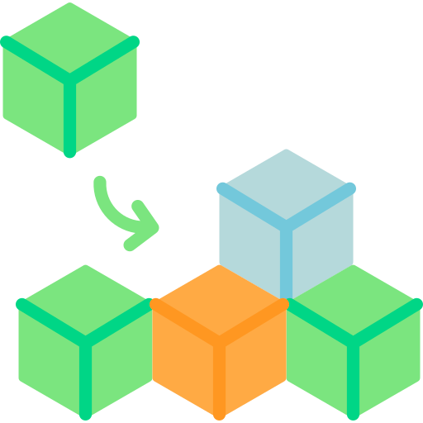
PROBLEM #7:
When vaccine recommendations change, we will want patients to be able to self-schedule for them.
Project Background:
Icon created by Freepik
Flaticon.com
GOAL #7:
Develop a modular, extensible process.

Slide 23
Agenda
Introduction
What we built
  Health Maintenance
  Decision Tree
  MyChart
  Timeline
Outcomes
Conclusions
Discussion
Icon created by Freepik
Flaticon.com

Slide 24

Health Maintenance (1 of 2)
Topic:
What is due?
What age does it start?
How frequently is it due?
Should patients see it in MyChart?
  Can patients self-schedule via MyChart?
Plan:
Who should be exposed to the Topic?
Icon created by Good Ware
Flaticon.com

Slide 25
Health Maintenance (2 of 2)
Mutually Exclusive
Icon created by Good Ware
Flaticon.com
HPV Topics & Plans x 3:
HPV optional start (age 9 yrs or 10 yrs) [Go Live: 2020]
  9 yrs or 10 yrs without prior dose of HPV vaccine
    Epic Galaxy: Use the American Cancer Society's Recommendations for HPV Vaccine Series
HPV vaccine
  Everyone age 11 yrs through 26 yrs [Go Live: 2012 & 2016]
  Any patient 9 yrs through 45 yrs with [Go Live: 2017 & 2023]
    Increased risk
    OR a prior dose
HPV optional start (age 27 yrs through 45 yrs) [Go Live: 2023-08-17]
  27 yrs through 45 yrs without prior dose of HPV vaccine

Slide 26
Agenda
Introduction
What we built
  Health Maintenance
  Decision Tree
  MyChart
  Timeline
Outcomes
Conclusions
Discussion
Icon created by Freepik
Flaticon.com

Slide 27
Scheduling Tree Schematic (1 of 3)
Conditional Questions Store Scheduling Tags
FLU due
and missing the tag?
“Do you want FLU vaccine?”
Y
Y
FLU
tag
MyChart
N
N
Influenza
Due October 1, 2023
SCHEDULE
MMR due and missing the tag?
“Do you want MMR vaccine?”
“Do you
want to schedule
for more than one
vaccine?”
Multiple vaccines due?
Y
Y
MMR tag
MMR
Due March 1, 2024
SCHEDULE
SCHEDULE
MMR tag
Y
Y
N
N
Varicella
Due March 1, 2024
SCHEDULE
N
N
VAR due and missing the tag?
“Do you want Varicella vaccine?”
Y
Y
VAR tag
Legend:
HM topic
N
N
Scheduling tag
Property determines earliest date
for selected vaccine(s) from stored tags
Decision node
Question for patient

Slide 28
Well Child Care visits are identified via Level of Service billing codes
99381:99385 and 99391:99395
Scheduling Tree Schematic (2 of 3)
Timely Well Child Care
This business rule was developed locally at MetroHealth with input of leadership using an algorithm of:
Expected frequency + 1 month
Age Range | Well Child Care Lookback
< 6 months | None
6 - 17 months | 4 months
18 – 35 months | 7 months
3 years – 18 years | 13 months
It governs whether children
6 months – 18 years will be offered a nurse visit (vs. only a provider visit)
It is built into rules in two contexts
(Appointment Entry Begin and
Appointment Entry Date Check)
and plugged into the Decision Tree
Children <6 months are excluded by department leadership from nurse visits to ensure that their immunizations are given only in provider visits.

Slide 29
Scheduling Tree Schematic (3 of 3)
Patient Characteristics Govern Appointment Type(s) Offered
Age
<6
mos
Age <13
yrs
Age
13 - 18
yrs
Age 19+
yrs
N
N
N
Y
Y
Y
Y
VFC
Legend:
Timely Well Child Care
Y
Decision node
N
N
Visit type(s) offered
Pharmacy
Desired
Y
N
Y
Nurse
OR
Provider
Visit
Provider Visit
Pharmacy Visit

Slide 30
Agenda
Introduction
What we built
  Health Maintenance
  Decision Tree
  MyChart
  Timeline
Outcomes
Conclusions
Discussion
Icon created by Freepik
Flaticon.com

Slide 31
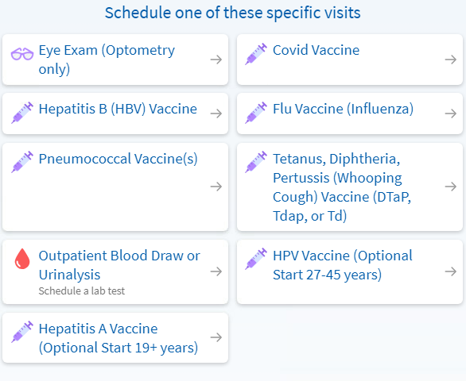
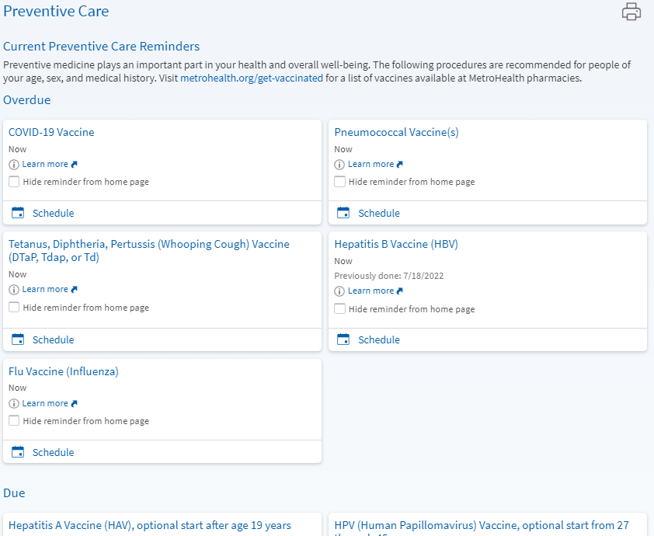
MyChart
Two places to start scheduling
Schedule a Visit
Preventative Care
Synthetic data

Slide 32
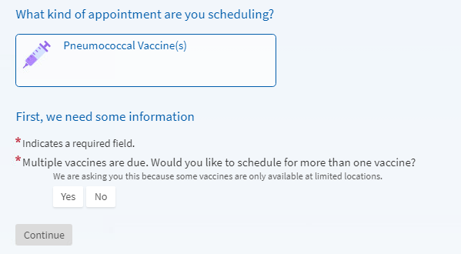
MyChart:
Multiple vaccines are due
Synthetic data

Slide 33
Agenda
Introduction
What we built
  Health Maintenance
  Decision Tree
  MyChart
  Timeline
Outcomes
Conclusions
Discussion
Icon created by Freepik
Flaticon.com

Slide 34

Project Milestones
Icon created by Freepik
Flaticon.com
Period | Event(s)
Spring and Summer 2022 | Kick-off meetings, development of specifications, and standardization of pediatric nurse visits throughout the Ambulatory network.
Fall 2022 | Building and testing.
January 2023 | Go-live for self-scheduling of all pediatric vaccinations, and influenza and COVID vaccines for adults.
March 2023 | Development and validation of Clarity reports.
Spring - Fall 2023 | Go-live for additional adult vaccinations (Pneumococcal; RSV optional & in pregnancy; HPV optional; Men-ACWY & MenB and Hib for risk).
November/December 2023 | Report refinement and data pull for self-scheduled vaccination appointments from January through December 2023. HIMSS Case Study.
January 2024 | Go-live of expanded Hepatitis A vaccine & Hepatitis B vaccine decision support for adults. Data analysis from January 2023 through May 2024.

Slide 35
Agenda
Introduction
What we built
Outcomes
  Patient testimonial
  Operational Data (January 2023 – January 2024)
Conclusions
Discussion
Icon created by Freepik
Flaticon.com

Slide 36
OUTCOMES
Patient testimonial:
Thank you for doing this!!
It was really hard to get my kids appointments for shots – it should not have been so difficult –
and I’m so happy to hear that we are making the care easier to access
☺ ☺ ☺

Slide 37
Agenda
Introduction
What we built
Outcomes
  Patient testimonial
  Operational Data (January 2023 – May 2024)*
Operational Conclusions
Discussion
Icon created by Freepik
Flaticon.com
* Clarity data pulled on 2024-02-08

Slide 38
OUTCOMES
In aggregate,
patients have used our functionality to self-schedule
17,073 immunization appointments.
(Jan 2023 – May 2024)
Appointments self-scheduled per month
Influenza & Updated COVID
Pediatric vaccines
& Adult Influenza & COVID
Adult Risk
Adult HPV optional
Adult RSV
optional
& pregnancy
We saw a spike in self-scheduled appointments at the start of the respiratory season as adult patients sought their influenza, COVID, and RSV optional vaccines.
Count of Visits
Month

Slide 39
OUTCOMES
Locations of Appointments
Patients took advantage of the availability of the Pharmacy.
Breakdown:
67% in the Pharmacy
26% with a nurse
7% with a provider
Count of Visits
Partial data
Month

Slide 40
OUTCOMES
Patients of all ages used the self-scheduling option.
Age Distribution
Age peaks were concordant with expectations from the CDC vaccination schedules (e.g., age 4, 11, and 16 years).
Count of Visits
Age in years

Slide 41
OUTCOMES
Status of Self-Scheduled Immunization Appointments (1 of 2)
57%
of visits were either No Show or Canceled
Percentage
3873
visits have been
Completed

Slide 42
OUTCOMES
Status of Self-Scheduled Immunization Appointments (2 of 2)
No Shows and Cancelations account for about
50% to 70% of visits per month
Count
Percentage
Month
Month

Slide 43
OUTCOMES
Number of Given Doses (1 of 2)
13,127
total vaccines doses
were given in 3873 completed appointments.
13,127
More than half were Influenza and COVID which were each given about 4x more frequently than the next most frequent vaccine
(RSV adult, see next slide).
Count of Doses
Count of Doses

Slide 44
OUTCOMES
Number of Given Doses (2 of 2)
15 different immunizations were administered
at least 100 times each during
self-scheduled appointments
(includes COVID & Influenza)
Count of Doses
Vaccine

Slide 45
OUTCOMES
Distribution of Requested vs. Given (1 of 2)
Patient often requested multiple vaccines
(39% of visits)
And they often got multiple vaccines during their self-scheduled visits
(42% of visits)

Slide 46
OUTCOMES
Comparison of Given vs. Requested (2 of 2)
Some patients got fewer vaccines than requested, and some got MORE vaccines than requested.
Percentage
This is a success of the pre-vaccination dialogue between the patient and their provider, nurse, or pharmacist.
Month

Slide 47
OUTCOMES
Evidence of advance planning
Patients took the opportunity to plan by self-scheduling some vaccines BEFORE they were due.
Count of Visits
Our custom functionality ensures that their self-scheduled appointments will occur only AFTER all the requested doses will be valid.
Count of Visits
Status in Health Maintenance at time of Scheduling

Slide 48
OUTCOMES
HPV Given to 27 yrs through 45 yrs
in Self-Scheduled Immunization Appointments
Patients 27-45 years got
HPV vaccine in
423
Self-Scheduled Immunization Appointments.
GO LIVE Health Maint. for HPV optional start
27 - 45 yrs
Count of Doses
These doses represented
64% (423 of 664)
of the total number of HPV doses given in Self-Scheduled Immunization Appointments.
Month

Slide 49
OUTCOMES
HPV Doses Given to 27 yrs through 45 yrs: Comparison of Self-Scheduled vs. Non-Self-Scheduled Immunization Appointments
Patients 27-45 years got 20% (423 of 2074)
of their HPV doses in Self-Scheduled Immunization Appointments.
The remainder were given in other appointments.
GO LIVE Health Maint. for HPV optional start
27 - 45 yrs
Count
Go Live for
Health Maintenance for HPV
optional start 27 – 45 years
was on 2023-08-17.
Month

Slide 50
Agenda
Introduction
What we built
Outcomes
Conclusions
Discussion
Icon created by Freepik
Flaticon.com

Slide 51

Conclusions (1 of 2)
Self-Scheduled Vaccination Appointments
Patients use it frequently
  Patients of all ages use our functionality
  Many different vaccines given
Within limits, the patient is in the driver’s seat regarding
  Which vaccines to request
  Appointment date
  Location
Staff appreciate the itemized request list on the schedule
We see evidence of successful dialogue and screening
  Some patients get fewer vaccines than requested
  Some patients get more vaccines than requested
Many visits are Canceled or No Show
Icon created by Freepik
Flaticon.com

Slide 52
Conclusions (2 of 2)
Health Maintenance & HPV Vaccine
Icon created by Freepik
Flaticon.com
We saw that the introduction into the EHR of Health Maintenance for HPV Vaccine Shared Decision-Making from 27 yrs through 45 yrs
  Was accompanied by a large rise in HPV doses given to that age group.
  Enabled a non-trivial number of patients to use MyChart Self-Scheduling functionality to obtain a dose of HPV vaccine.
  But most doses of HPV vaccine given in this age group, were given in non-Self-Scheduled Immunization Appointments.
We do not know what was discussed in the Shared Decision-Making conversations between patients and their immunization providers.

Slide 53

Credits
Icon created by Muhammad Ali
Flaticon.com
David Bar-Shain [Physician Programmer]
Patricia Krall [Cadence Analyst]
Jonathan Lewis [Cogito Analyst]

Slide 54
References
Bar-Shain, DS (2023). Self-Scheduled Vaccinations via MyChart: Empowering Patients & Increasing Access. Unpublished manuscript. HIMSS Stage 7 Case Study.
Bar-Shain DS. “Using a Table to Look Something Up” in The other MUMPS: Physician Programmers Explain Their Code. Physician’s Advisory Council: Expert Group Meeting, Epic Systems Corp. (May 2023)
https://eventarchive.epic.com/Past%20Events/2023%20Events/XGM/Physicians%20Advisory%20Council%20(PAC)/PAC20%20The%20Other%20MUMPS%20-%20Physician%20Programmers%20Explain%20Their%20Code.pdf
Centers for Disease Control and Prevention. (2023, December 6). Adult immunization schedule notes. Centers for Disease Control and Prevention. https://www.cdc.gov/vaccines/schedules/hcp/imz/adult-schedule-notes.html#note-hpv
Centers for Disease Control and Prevention. (2022, June 5). Shared Clinical Decision-Making HPV Vaccination for Adults Aged 27-45 Years. Retrieved February 18, 2024, from https://www.cdc.gov/vaccines/hcp/admin/downloads/isd-job-aid-scdm-hpv-shared-clinical-decision-making-hpv.pdf
Epic Systems Corp. (2024). Use the American Cancer Society’s Recommendations for HPV Vaccine Series. Immunization Scheduling Setup and Support Guide. https://galaxy.epic.com/?#Browse/page=1!68!50!3664677,3664712,100244422&rank=1&queryid=117348590&docid=98303

Slide 55
Agenda
Introduction
What we built
Outcomes
Conclusions
Discussion
Icon created by Freepik
Flaticon.com

Slide 56
Discussion:
Using your lenses of Population Health & Health Disparities what research questions do you have about self-scheduled vaccinations via MyChart?
Is it appropriate to forecast Shared Decision Making for HPV vaccine for adults 27 yrs through 45 yrs via Health Maintenance and show it to providers?
Is it appropriate to share Shared Decision-Making forecasts with patients?
Icon created by Freepik
Flaticon.com

Slide 57

Thank you! dbarshain@metrohealth.com
Icon created by flatart_icons
Flaticon.com

